Slide 1
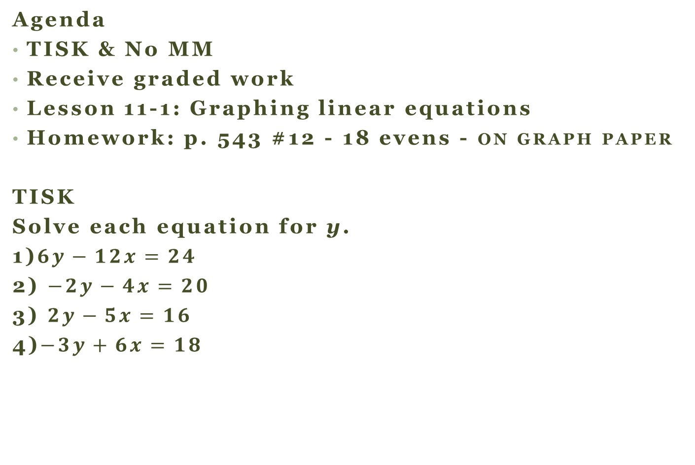
Monday, December 3, 2012
Agenda
TISK & No MM
Receive graded work
Lesson 11-1: Graphing linear equations
Homework: p. 543 #12 - 18 evens - ON GRAPH PAPER
TISK
Solve each equation for y.
1)$6y−12x=24$
2) $−2y−4x=20$
3) $2y−5x=16$
4)$−3y+6x=18$
Have a signed Ch. 9 Test to show me?
Have it out on your desk!
Notes:
Pd 1: 8:20 – 8:55
Pd 2: 9:00 – 9:40
Pd 6: 12:20 – 1:00

Slide 2
§11.1 Graphing Linear Equations
I should write this down!
For any equation with an x and a y, there are many solutions that fit the equation.
Each solution can be written as an ordered pair:
(-3, -10), (13, 6), and (0, -7)
A graph of an equation is simply a picture of
all solutions of an equation.
Notes:
Pd 1: 8:20 – 8:55
Pd 2: 9:00 – 9:40
Pd 6: 12:20 – 1:00

Slide 3
How do you tell if an equation is linear?
Graph it:
  Does it make a straight line? Then it’s linear!
Look at the variables:
  If x and y have exponents of 1 each, then it’s linear!
Notes:
Pd 1: 8:20 – 8:55
Pd 2: 9:00 – 9:40
Pd 6: 12:20 – 1:00

Slide 4
Graph the equation.
(-3, -10), (13, 6), and (0, -7)
x
I can just read along here
This line represents ALL the points that satisfy the equation y = x – 7.
y
Notes:
Pd 1: 8:20 – 8:55
Pd 2: 9:00 – 9:40
Pd 6: 12:20 – 1:00

Slide 5
Weird Equations
I should write this down!
How do you find solutions of equations where either the x or the y is missing?
  For example:
x | y
x | y
Notes:
Pd 1: 8:20 – 8:55
Pd 2: 9:00 – 9:40
Pd 6: 12:20 – 1:00

Slide 6
Writing Equations in Function Form.
I should write this down!
What is “function form”?
When an equation is written so that y is isolated.
Solve for y in terms of x.

Slide 7
How to Graph an Equation
Write the equation in function form.
Choose 3 values of x.
(one positive, one negative, and zero)
Solve for y using each chosen value of x.
List your results in a table.
Plot the points on a plane.
Connect the dots!
I should write this down!

Slide 8
Use a table of values to graph the equation.
x |  | y
-3
-2
0
2
x
3
6
I should write this down!
y
Notes:
Pd 1: 8:20 – 8:55
Pd 2: 9:00 – 9:40
Pd 6: 12:20 – 1:00

